Slide 1
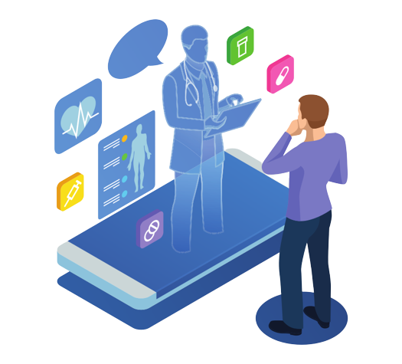
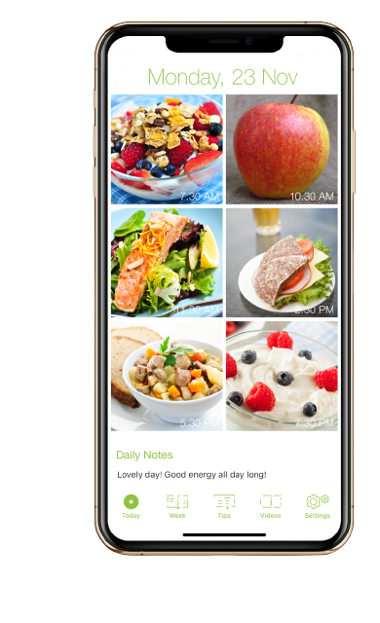



User
User first Login into
The app
What type of Nutrition we have taken by day by day
Nutrition Level low you will consulting with doctor
Logout
01
2
4
3
5

